Slide 1
Part 1: Definitions, Functions, and Electronic Components
MercedEnergy.com
12-13-2018

Slide 2
Functions : digitalWrite()
Syntax
digitalWrite(pin,value)
Parameters
pin : the pin number
value: HIGH or LOW

Slide 3
Functions : pinMode()
Configure behavior of the pin
Syntax
pinMode(pin,mode)
Parameters
pin: pin number whose mode will be configured
mode: INPUT, OUTPUT

Slide 4
Functions : analogWrite()
Works on pins 3, 5, 6, 9, 10, and 11
Light a LED at varying brightnesses or drive a motor at various speeds
Syntax
analogWrite(pin,value)
Parameters
Pin to write to
O to 255 (0V to 5V)

Slide 5
Definitions
PWM - Pulse Width Modulation. From HIGH to LOW as fast as possible, then it takes the average.
Used to control dimming LEDs
LED - Light Emitting Diode
Anode - Positive side of LED
Cathode - Negative Side of LED
Sketch
It's the unit of code that is uploaded to and run on an Arduino board

Slide 6
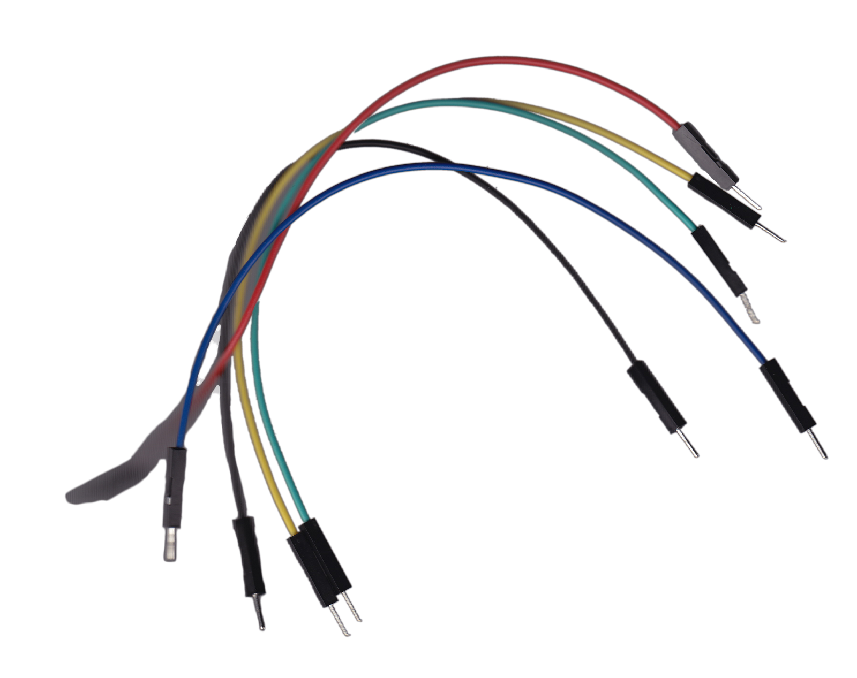
Components : Jumper Wires
Used for prototyping. No need to solder.
Typically used on breadboards.
Wires are all the same.
Colors
may be used to differentiate function.
Types
Male-Male
Male-Female
Female-Female
Male-Male

Slide 7
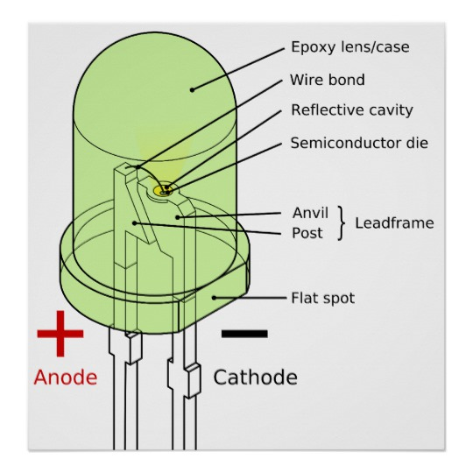
Components : LED
Light Emitting Diode
Anode is Positive
Long Leg
Cathode is Negative
Short Leg

Slide 8
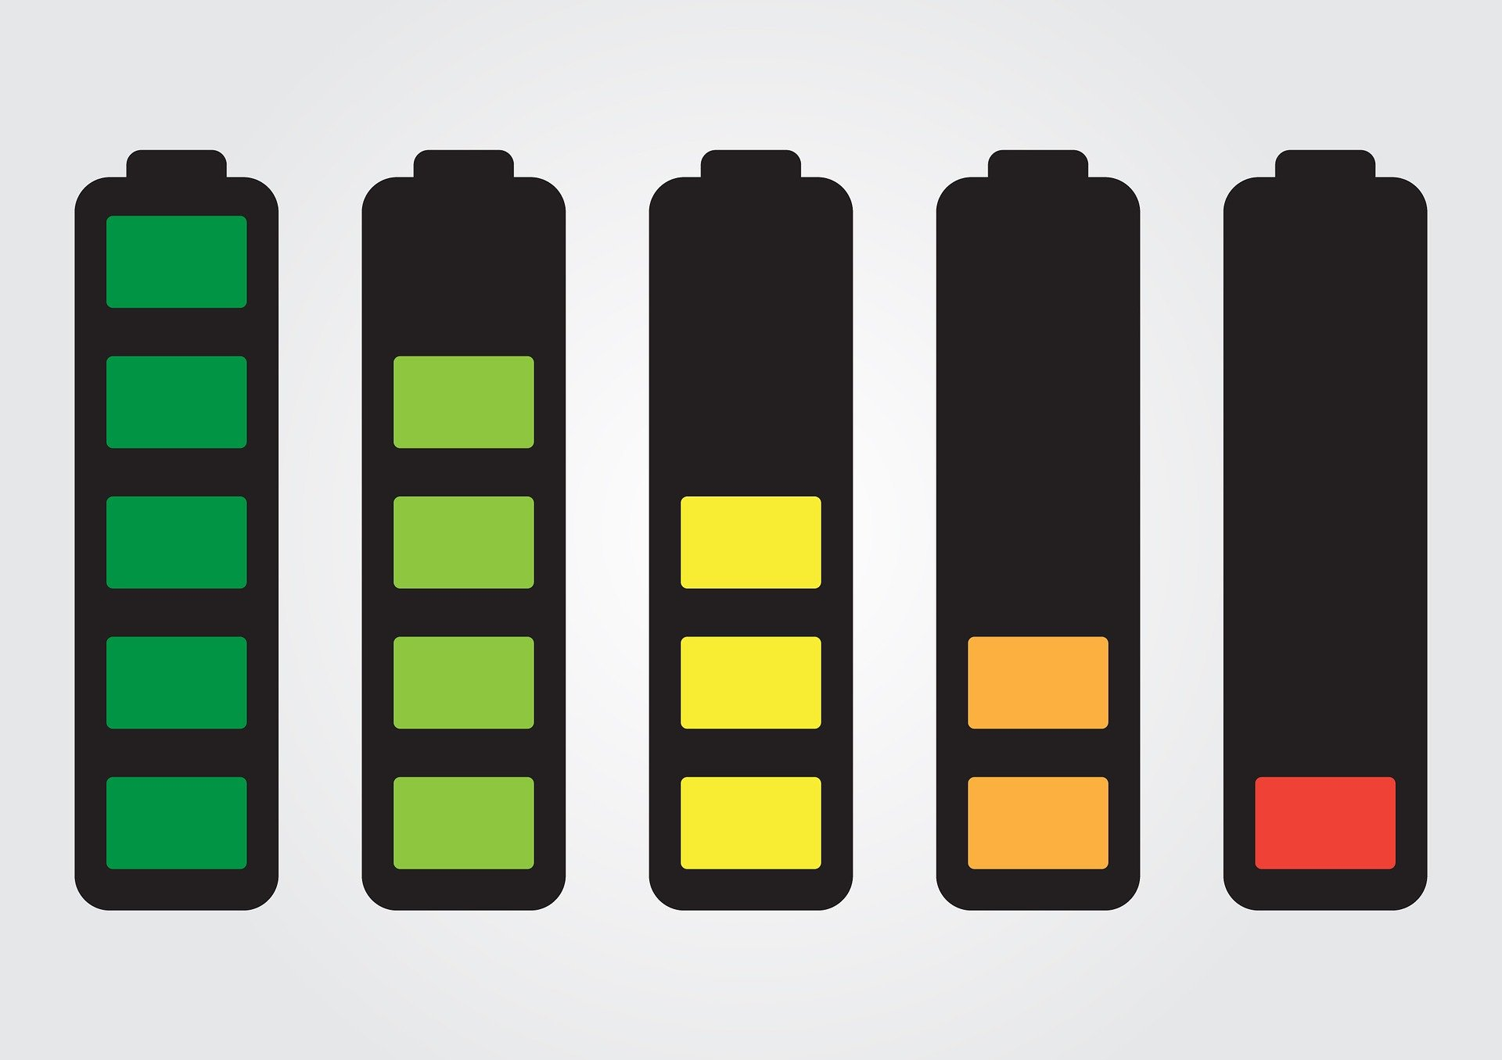
Components : Battery
Batteries com in different sizes and shapes.
Cylindrical
Prismatic
Pouch
Voltage
Difference between points.
Current
Moving electrons in a wire

Slide 9
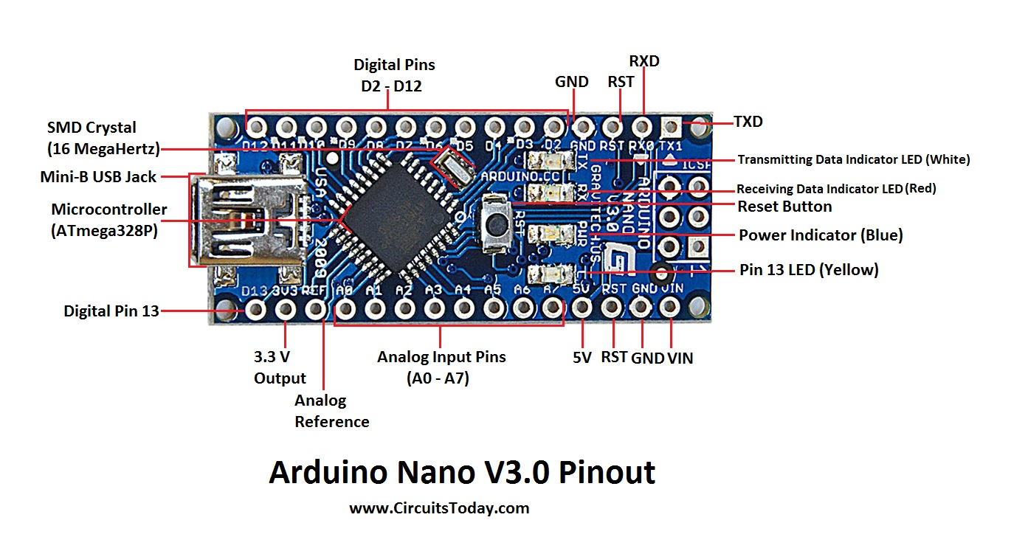
Components : Arduino Nano
Made of multiple components
Microcontroller
ATmega328

Slide 10
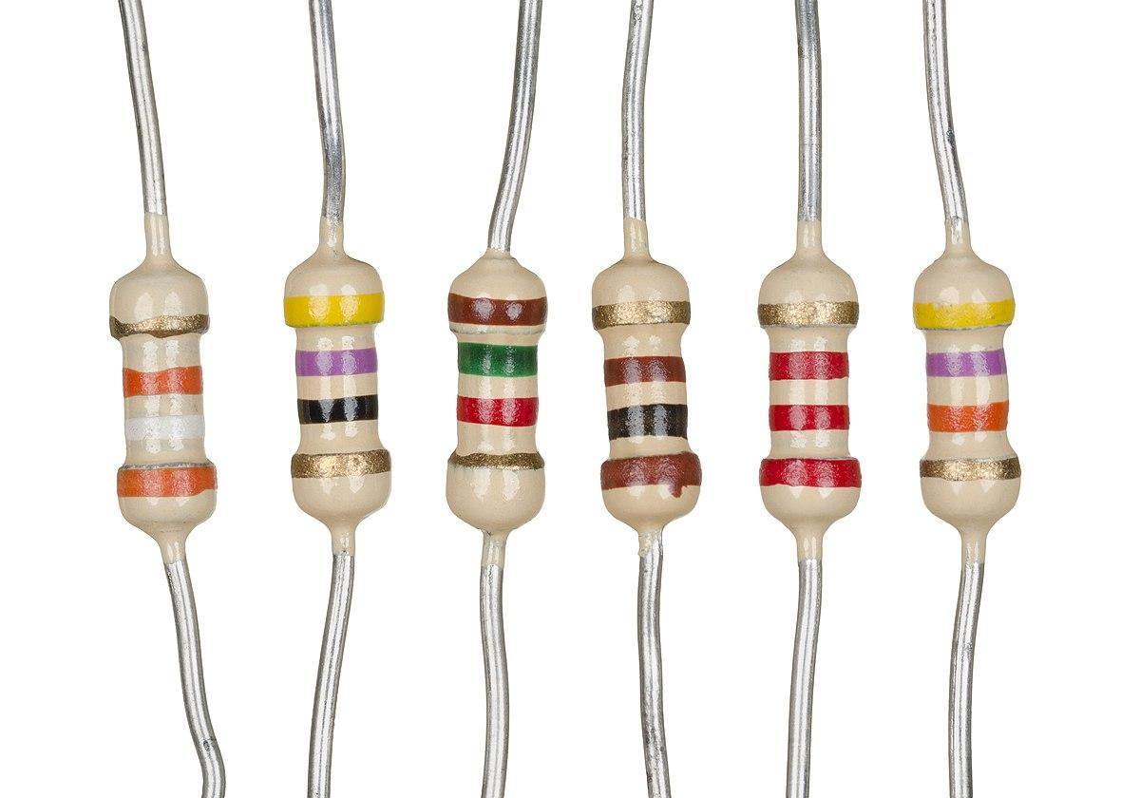
Components : Resistor
Limits the amount of current
LED may burn
Components that use electricity may burn if to much current is applied.
Resistance is measured in Ohms
Resistor bands determine amount of resistance
https://www.instructables.com/id/How-to-read-color-codes-from-resistors-1/

Slide 11
Thank You!
Ramiro Gonzalez
209-962-2524
ramirogonzalez@mercedenergy.com
ramirogonzalez.org

Slide 12
Sources and Websites
Arduino.cc
Ciruitstoday.com
Amariei, Cornel. Arduino Development Cookbook. Packt Publishing, 2015.
Sparkfun.com
https://www.instructables.com/id/How-to-read-color-codes-from-resistors-1/

